Slide 1
Politics & Twitter
Talha Oz
Center for Social Complexity
George Mason University
02/20/2015
Source code & datasets are on GitHub

Slide 2
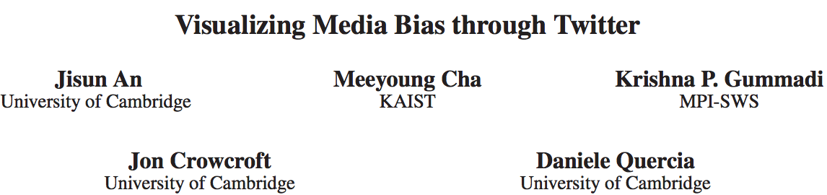
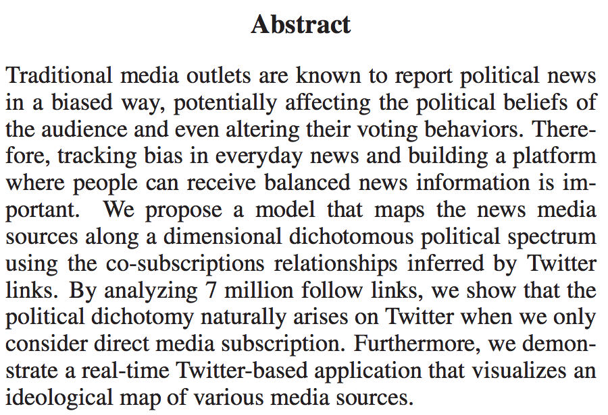
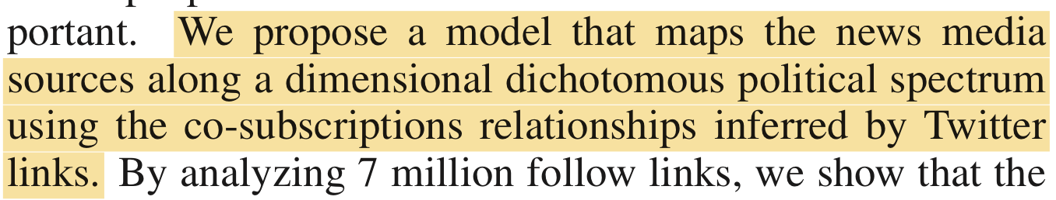

Slide 3
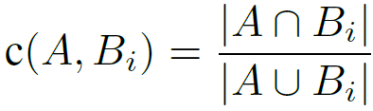
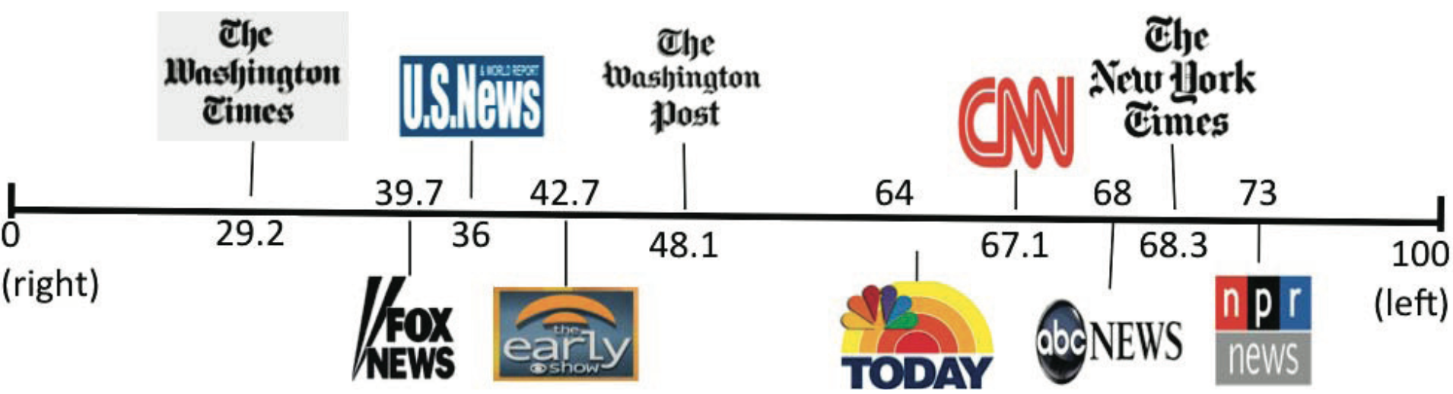
Political leaning of US news media sources
24 news media
Jaccard for closeness
Global network positioning (GNP) to scale
media bias measure, named ADA (Americans for Democratic Action) score

Slide 4

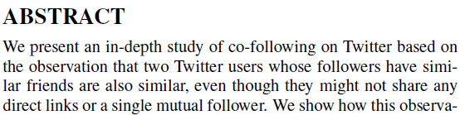

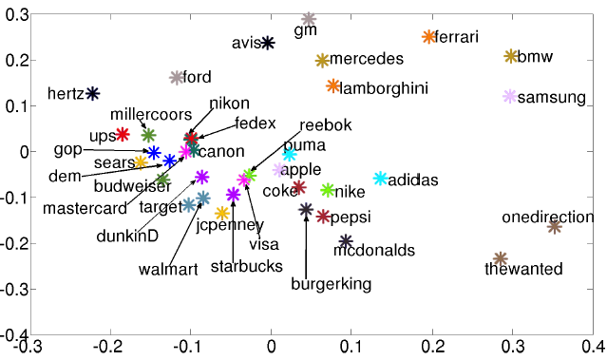
“lifestyle politics” can be studied by using co-following information…
Similarly, @GM and @Avis are very close in the low-dimensional embedding. Again, this makes sense as “[s]ince
the late 1970s, Avis has featured mainly General Motors (GM) vehicles”…
…are still useful for
online advertising…

Slide 5
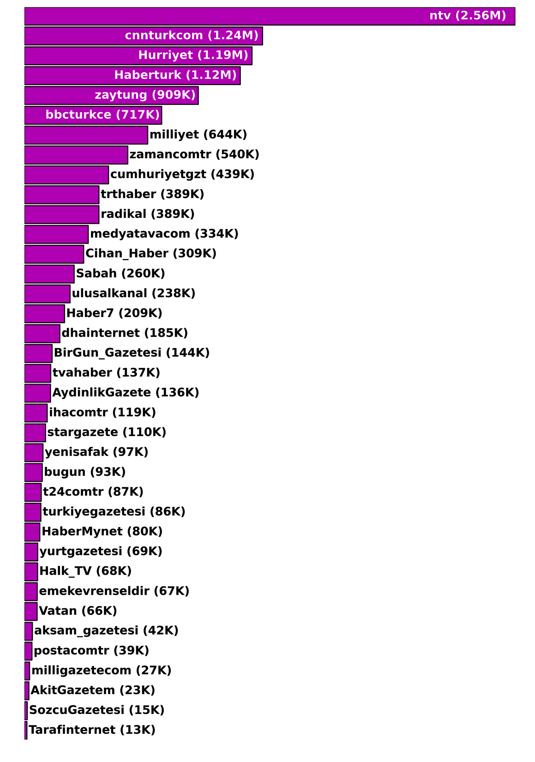
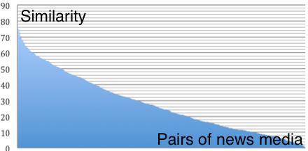
Polarity of Turkish News Media
Meet/min
Weighted Graph
Community Detection
A modularity based method (Gephi)

Slide 6
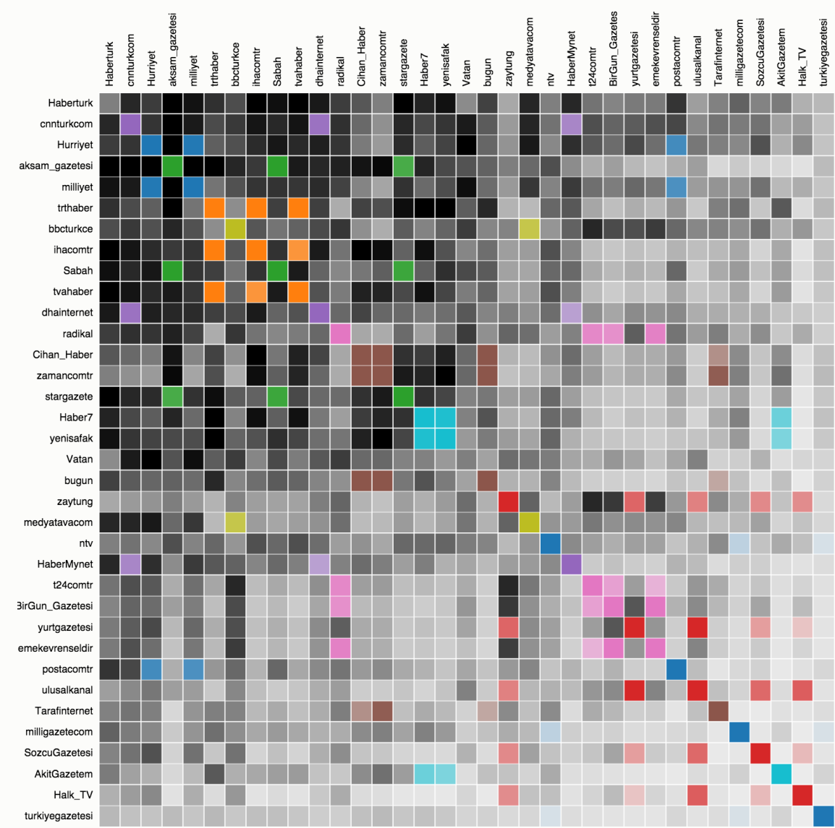
Visualizations Beyond 1-D
Media similarity matrix with D3
Similarity view
Selective exposure or blinkers ?
Cluster view (weak validation)
List of newspapers in Turkey (Wiki)
Dogan Media Group (Wiki)
Former Milli Gorus (Facebook post)
Gulen Movement (Today’s Zaman)
Socialism, Leftism (Radikal)
Nationalism, Kemalism (Tweet)

Slide 7
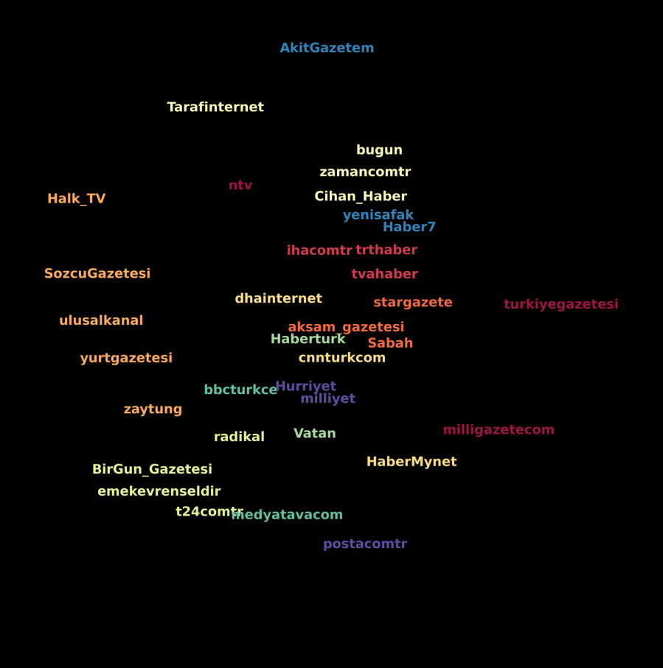
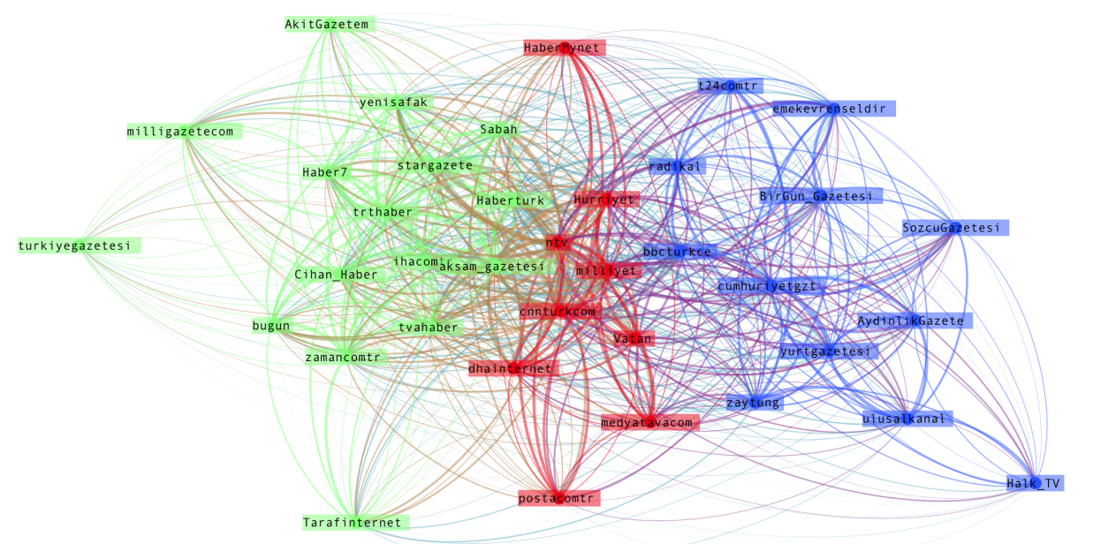
Turkish Media in 2D
Multidimensional Scaling (sklearn.manifold.MDS)
Similarity to distance matrix
Turkish media networks (Force Atlas Layout 2, Gephi)
Force Directed Drawing
Colors are for 11 clusters

Slide 8
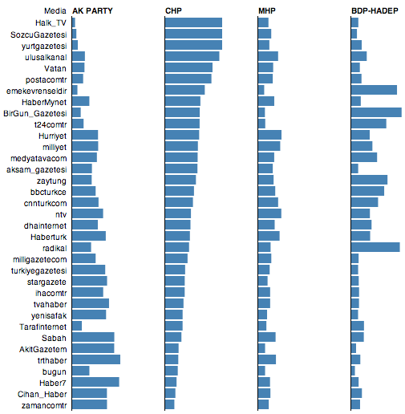
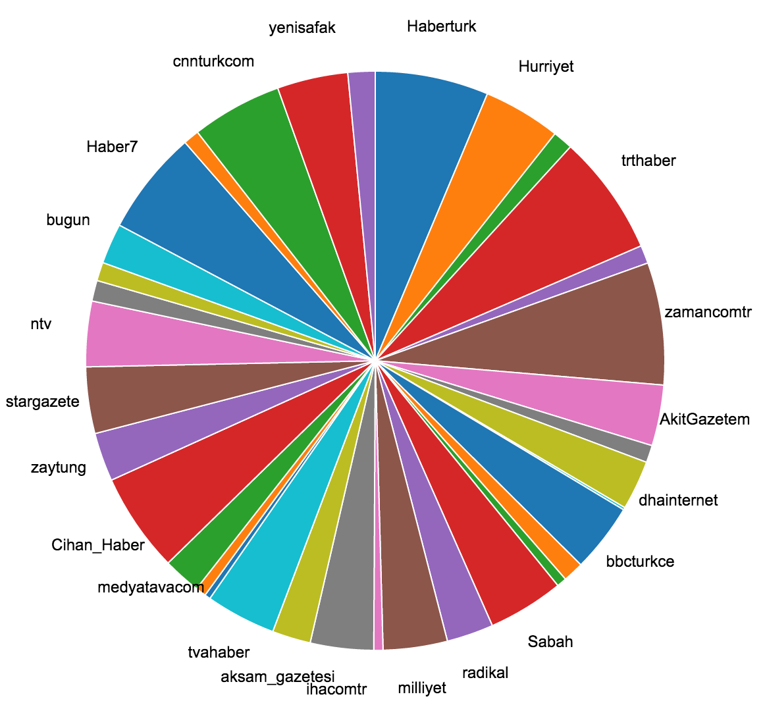
Political Groups & News Media
Media Preference of Five Groups in Turkey
Group Descriptiveness of the Turkish Media
Bar length = (similarity of party x to media y) / (sum of all party sims to y)
AKP

Slide 9
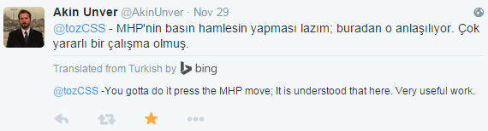


Slide 10
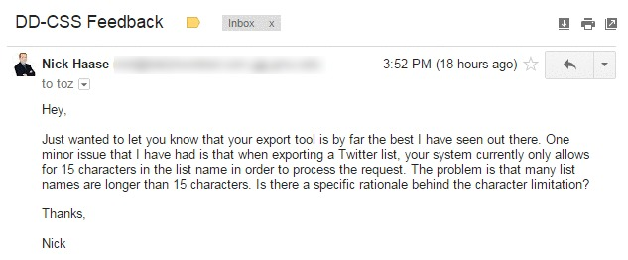
DD-CSS
Data-driven Computational Social Science
is an effort to build new tools to help collect and analyze social media data
I did not know about any data collection tools (now there is a list)
tools for network analysis Gephi, Pajek and UCINET
powered by Flask, a highly modular microframework for Python

Slide 11
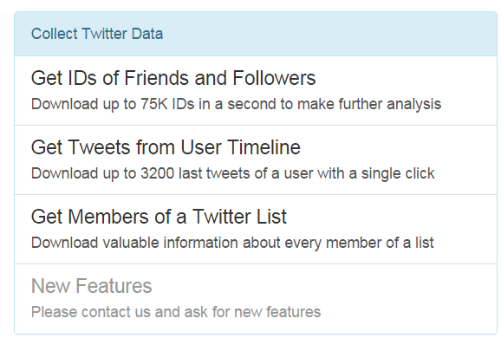
DD-CSS Demo
http://dd-css.com/
US-senate.csv

Slide 12
Commentary Tweets of the Elites
Curated tweets of opinion-shapers and newsmakers
By nediyor.com and theplazz.com news sites
Commentaries on important events (news that have made to headlines) between Jan 2013 and Jan 2015.
“our visitors are plugged into the national conversation through up-to-date commentary that is insightful, humorous, combative, thought-provoking and just plain newsworthy.”

Slide 13
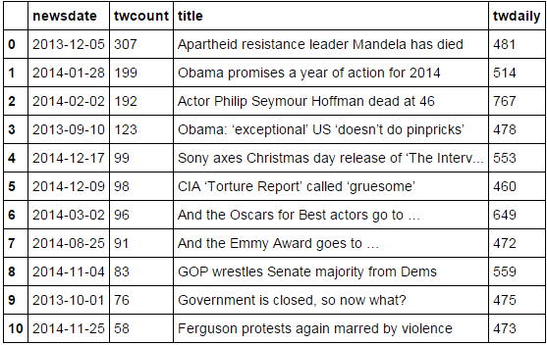
Early findings…
http://talhaoz.com/news/
https://plot.ly/~toz/199/turkish-newsmaker-commentators-by-profession-curated-by-nediyorcom/

Slide 14
Politics…
Newsworthy Tweet Counts of TR Parties plotly
http://talhaoz.com/news/US-Congress-Commentators.html
Politician counts curated
Activity of these politicians
Which events/news got the most attention
When comment-count differences maximized

Slide 15
Wrap Up
Detecting Media Conglomerate and Groups using Twitter
Political Group Descriptiveness of the News Media
DD-CSS: A social media data collection platform
Commentary Tweets of the Elites and Congresspeople
Turkish Election Maps and Scenario Analysis

